Slide 1
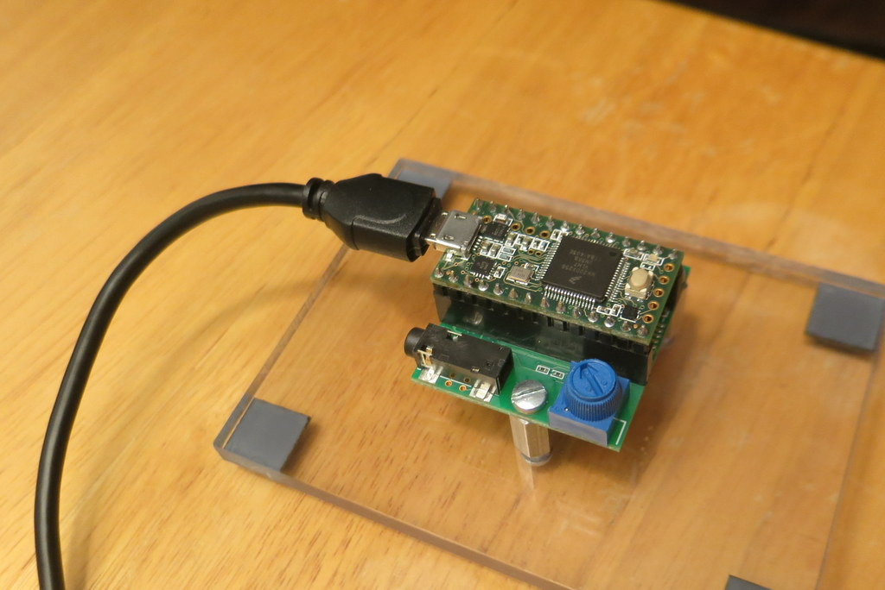
No Audio Cables…
…Except for USB!

Slide 2
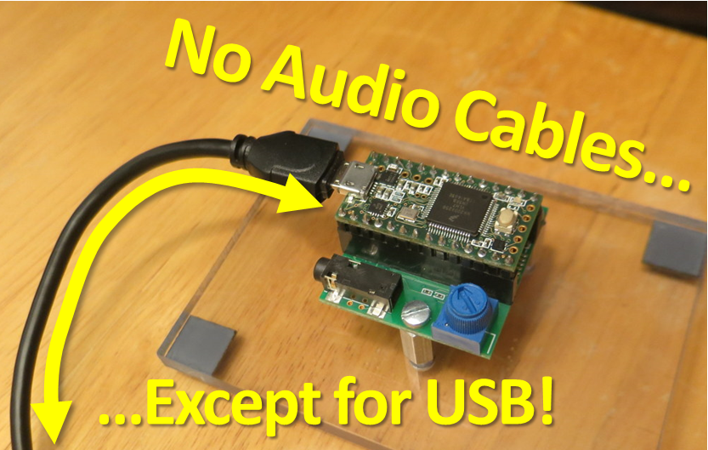

Slide 3
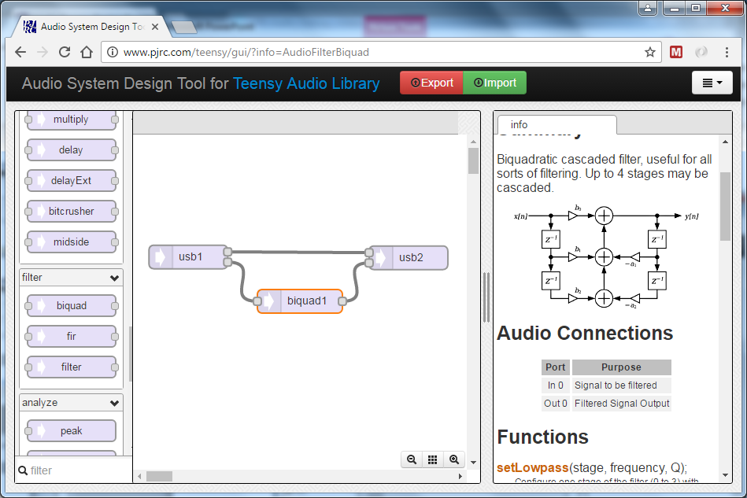
Input
Output
Filter
(Note: Doesn’t Work)

Slide 4
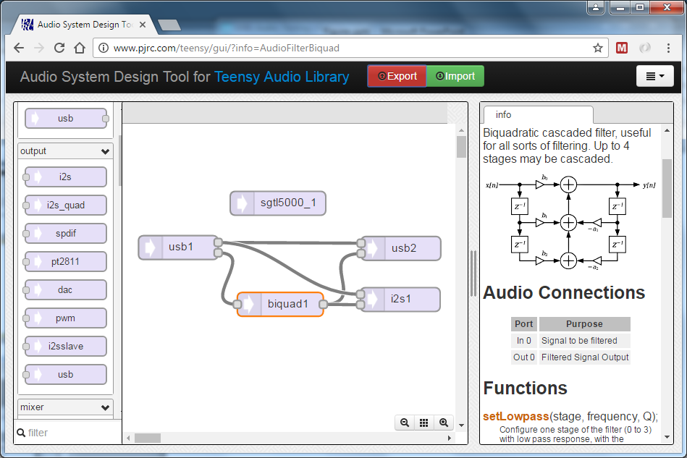
Added
Added

Slide 5
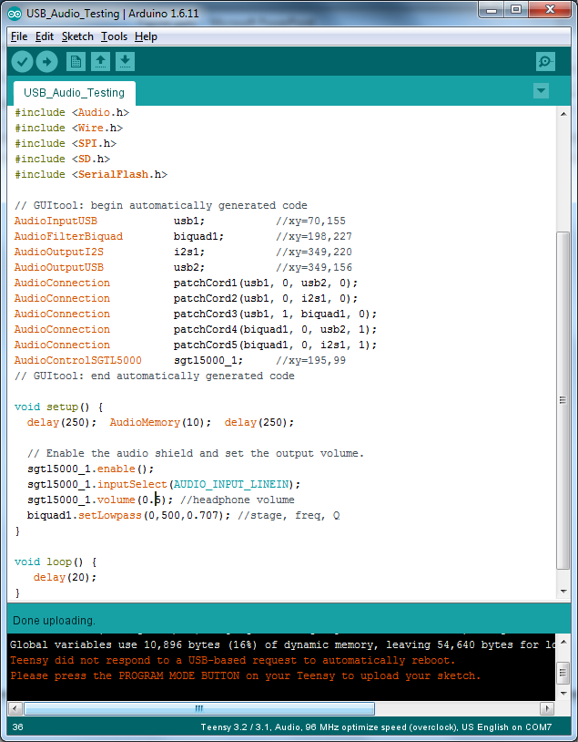
From Teensy
Audio Design
GUI
Add This
Yourself

Slide 6
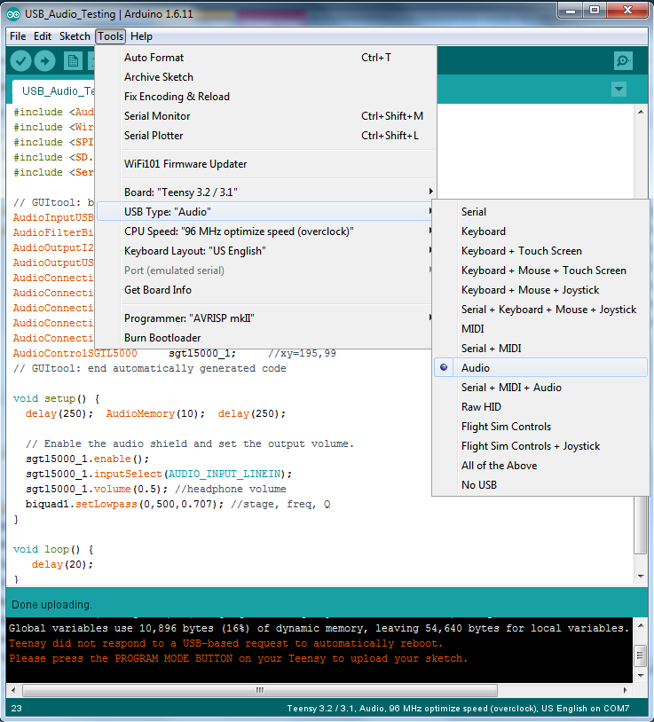

Slide 7
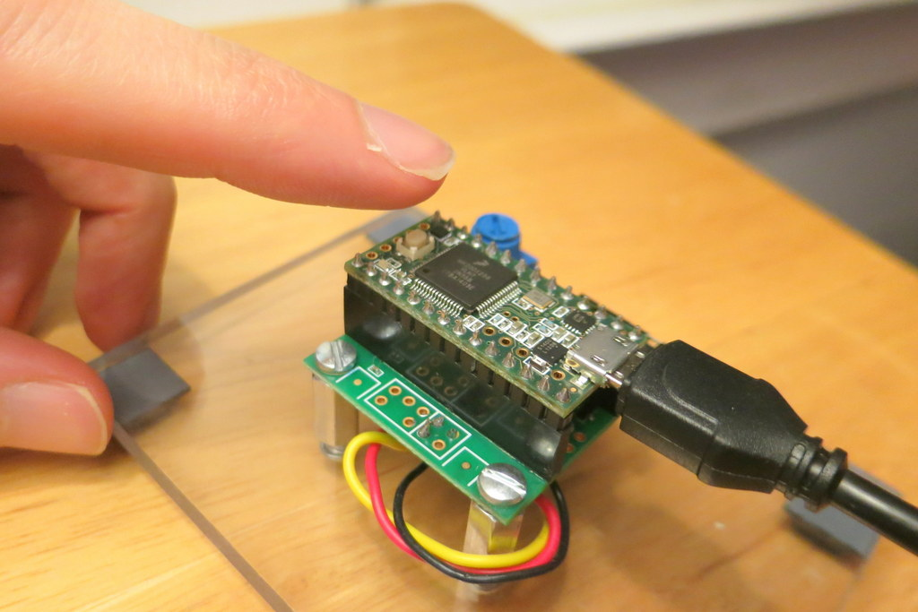
When Configured for USB Audio…
Press the Button to Re-Program

Slide 8
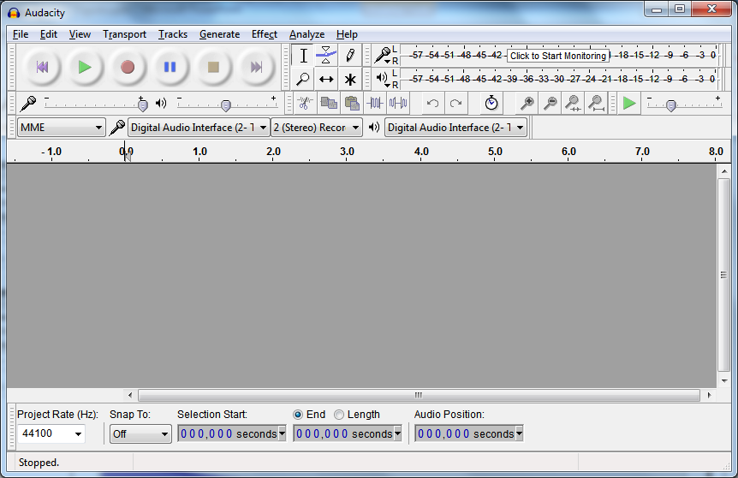
Change to MME
Change to Teensy
Change to Stereo
Change to Teensy
Configuring Audacity (in Windows 7)
To Send and Get Teensy Audio over USB
Change to 44100

Slide 9
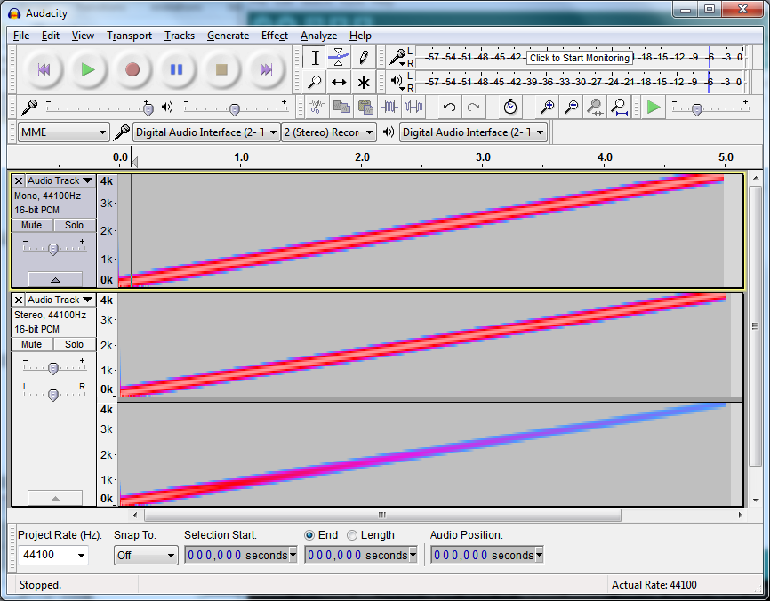
Generated in Audacity:
Original Signal
From Teensy:
Not Effected
From Teensy:
Low-Pass Filtered

Slide 11
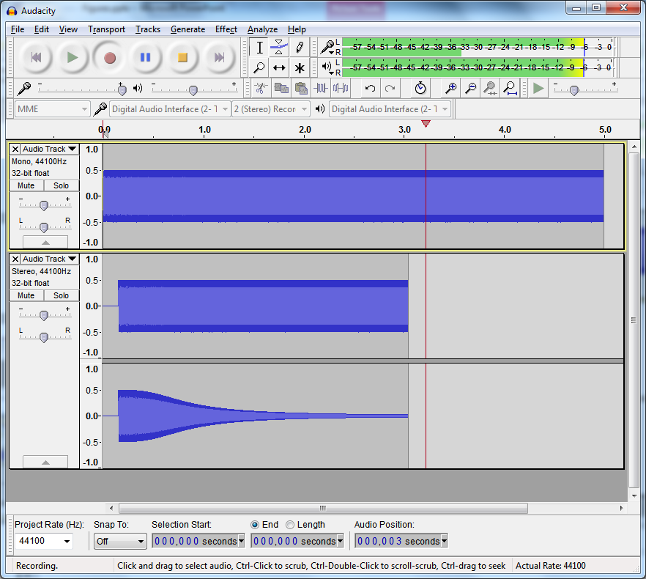
Change to MME
Change to Teensy
Change to Teensy
Generate in Audacity
From Teensy (Left)
From Teensy (Right)
Change to 44100

Slide 12
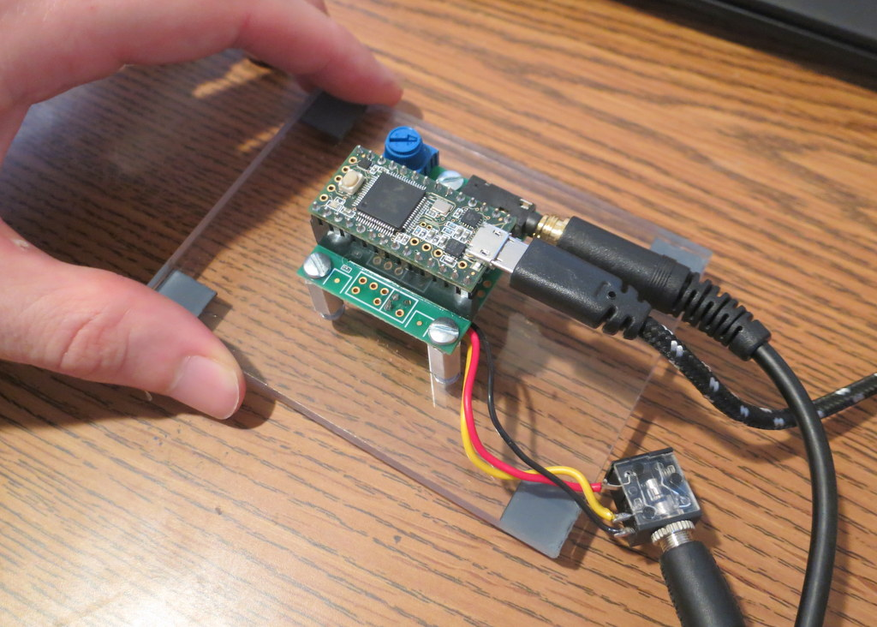
Turn Pot
Teensy 3.2
Headphone
Audio Board
USB
Line-In

Slide 13
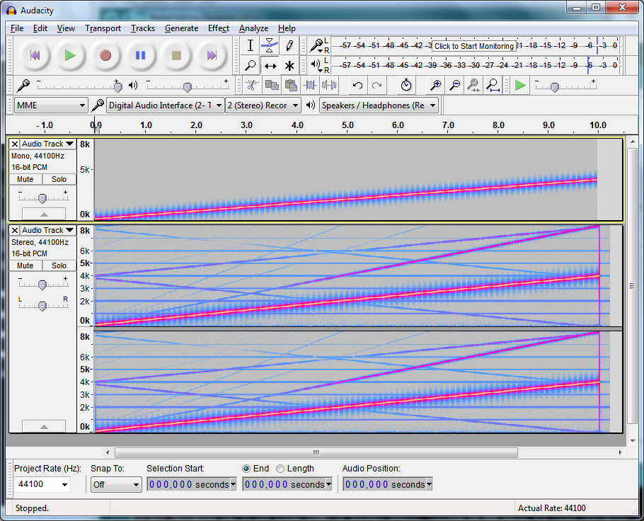
Test Signal to Teensy
Audio from Teensy USB

